Slide 1
Week 6 Presentation

Slide 2
Model Complexity Comparison
LSTM has 566,601 trainable parameters
RNN has 141,801 trainable parameters

Slide 3
Attempted New Approach
Multi-class classification (3 labels: 0,1,2)
0: no peak, 1: one peak, 2: two or more peaks
Also changed training set to velocity transfer functions instead of displacement

Slide 4
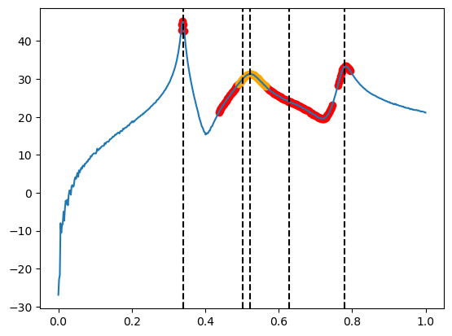
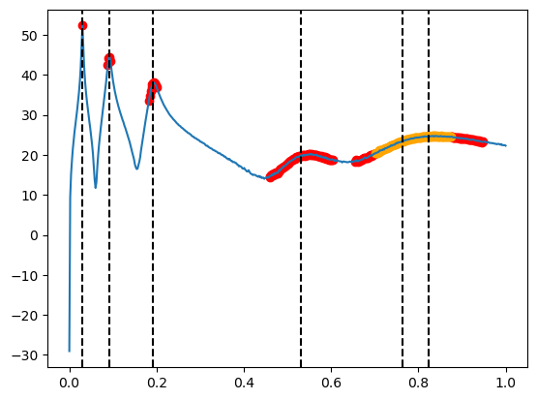

Slide 5
Training
Attempted to train two models, one with normalisation, other without
Need to change weighting for different classes in loss function so that we are not overpredicting massively

Slide 6
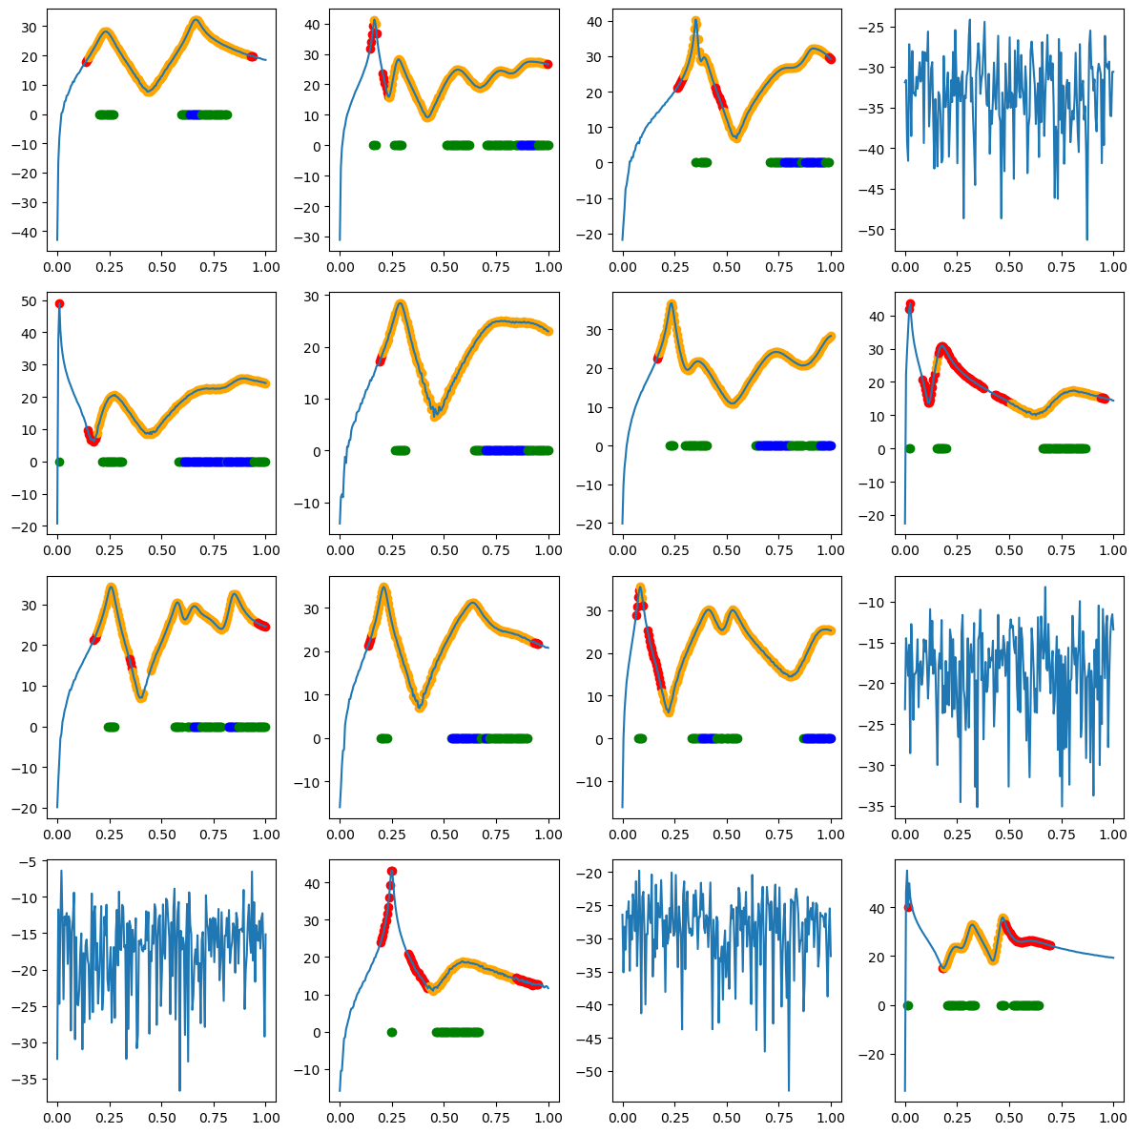
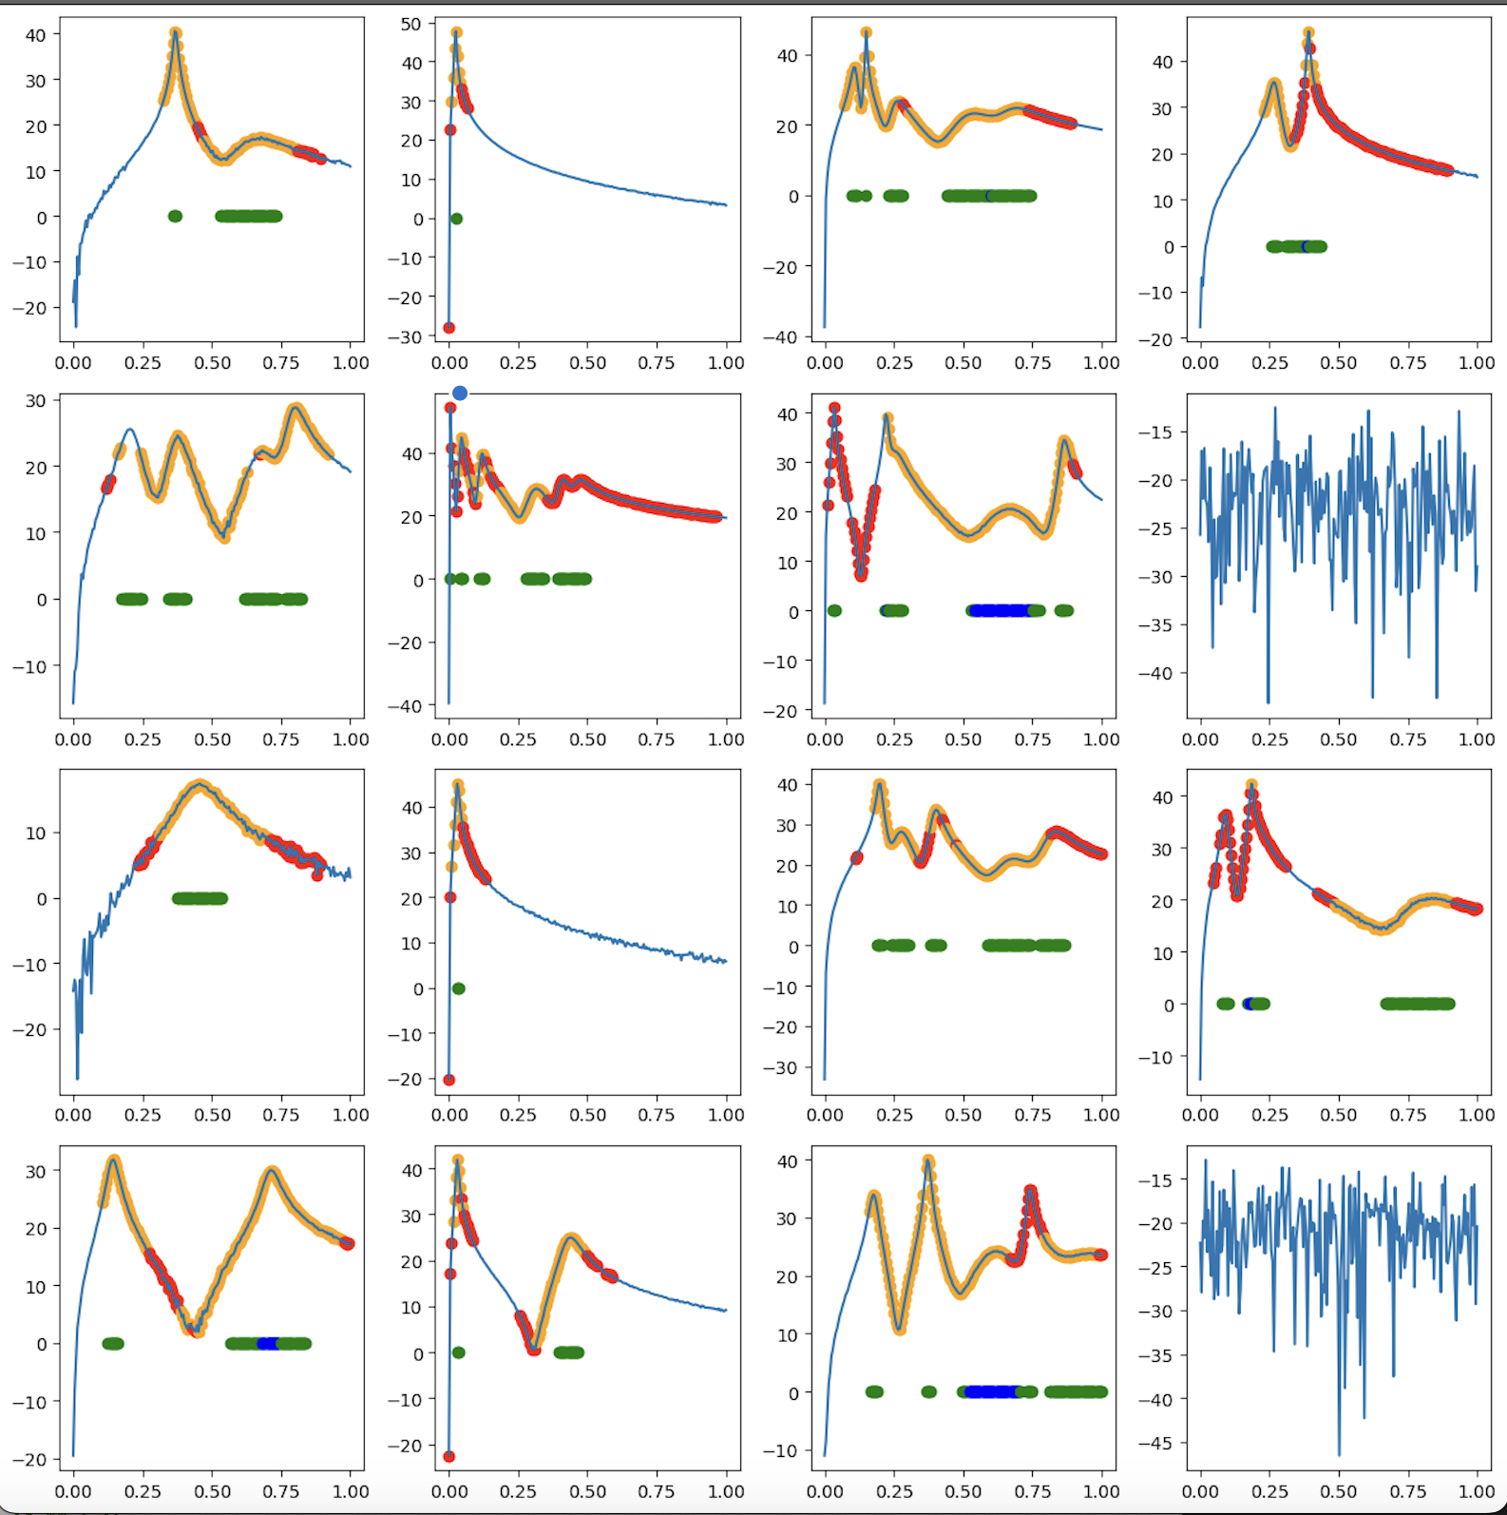
Model 1 (no normalisation)

Slide 7
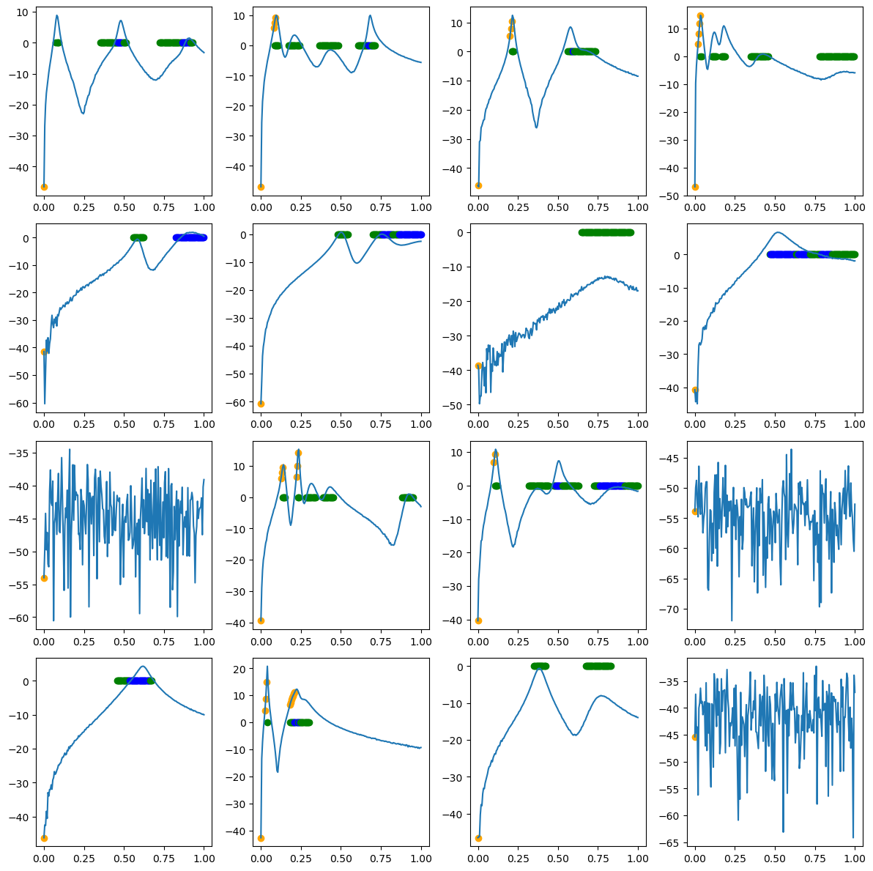
Model 2 (normalisation)
Not predicting well, seems to only ever predict label 2.
Also always predicts first item as 2+ peaks, not sure why

Slide 8
Presentation

